Slide 1

Predicting Car Accident Severity in Seattle, USA
IBM Data Science Capstone
Ryan W

Slide 2
BUSINESS PROBLEM
In the United States, road traffic crashes are a leading cause of death for people aged between 1 – 54 years. Globally, every day, almost 3,700 people are killed in road traffic crashes and are estimated to be the 8th leading cause of death.
Road traffic crashes cost countries 3% of their gross domestic product. In 2010, motor vehicle crashes cost USA $242 billion. However, with quality-of-life valuations considered this value increases to $836 billion.
With such a large impact on both the lives of those living in the United States, as well as the country’s economy, there is a keen interest to develop machine learning models to better predict causes of road traffic crashes to develop preventative measures.

Slide 3
INTENDED AUDIENCE
1
Insights will provide information related to areas prone to areas to accidents and their cause effect, which can lead towards the development of interventions in speed management, infrastructure design and enforcement of traffic laws.
SEATTLE COUNCIL
2
INSURANCE COMPANIES
Insights will provide information to district areas that have high accident counts for both fatalities and minor crashes such as sideswiping of parked cars. This can lead towards requiring owners pay an increased premium on their car insurance to reduce the risk for the insurance company.
3
For the health care department, insights will provide information on areas that have high accident counts that require medical assistance and the type of treatment required. This can lead towards improved resource allocation in areas of high road traffic crashes, development of post-crash survival strategies and training for relevant staff.
HEALTH CARE

Slide 4
THE DATASET
Attribute | Description
OBJECTID | ESRI unique identifier
SHAPE | ESRI geometry field
INCKEY | Unique key for the incident
COLDETKEY | Secondary key for the incident
ADDRTYPE | Collision address type
INTKEY | Key that corresponds to the intersection associated with a collision
LOCATION | Description of the general location of the collision
EXCEPTRSNCODE
EXCEPTRSNDESC
SEVERITYCODE | Code that corresponds to the severity of the collision
SEVERITYDESC | Detailed description of the severity of the collision
COLLISIONTYPE | Collision type
PERSONCOUNT | Total number of people involved in the collision
PEDCOUNT | Number of pedestrians involved in the collision
PEDCYLCOUNT | Number of bicycles involved in the collision
VEHCOUNT | Number of vehicles involved in the collision
INJURIES | Number of total injuries in the collision
SERIOUSINJURIES | Number of serious injuries in the collision
FATALITIES | Number of fatalities in the collision
INCDATE | Date of incident
INCDTTM | Date/time of incident
JUNCTIONTYPE | Category of junction at which collision took place
SDOT_COLCODE | Code given to the collision by SDOT
SDOT_COLDESC | Description of the collision corresponding to the collision code
INATTENTIONIND | Whether or not collision was due to inattention
UNDERINFL | Whether or not a driver involved was under the influence of drugs or alcohol
WEATHER | Weather conditions during the time of the collision
ROADCOND | Road conditions during the collision
LIGHTCOND | Light conditions during the collision
PEDROWNOTGRNT | Whether or not the pedestrian right of way was not granted
SDOTCOLNUM | Number given to the collision by SDOT
SPEEDING | Whether or not speeding was a factor in the collision
ST_COLCODE | Code provided by the state describing the collision
ST_COLDESC | Description that corresponds to the state’s coding designation
SEGLANEKEY | A key for the lane segment in which the collision occurred
CROSSWALKKEY | A key for the crosswalk at which the collision occurred
HITPARKEDCAR | Whether or not the collision involved hitting a parked car
Data that outlines the collisions in the Seattle area from the year 2004 to current can be found here.
And the metadata can be found here.
The data is collected by the SDOT Traffic Management Division and is updated weekly.
It includes data of all types of collisions across all types of transportation methods.
The dataset, at the time of writing this report, contains 194,673 reported accidents.

Slide 5
DATA PREPARATION
1
All rows that had the data point of NEI (not enough information) in the column EXCEPTRSNCODE were removed. This was because the data point indicated that the entire row had corrupt data.
REMOVE CORRUPT DATA
Columns that had no relevance to the prediction of an accident or were data points from after the accident and so irrelevant in the prediction were removed. These columns were:
EXCEPTRSNCODE, EXCEPTRSNDESC, INTKEY, INCKEY, COLDETKEY, SEGLANEKEY, CROSSWALKKEY, SEVERITYCODE.1, REPORTNO, SEVERITYDESC, SDOTCOLNUM, ST_COLDESC, LOCATION, STATUS, X, Y, INCDATE, INCDTTM, SDOT_COLCODE, SDOT_COLDESC
2
REMOVE UNSUITBALE FEATURE ATTRIBUTES
3
REMOVE NULL VALUES
All null values from important columns were removed.

Slide 6
DATA PREPARATION CONT.
4
The categorical data points needed to be converted to numerical, so that they could then be run through ML modelling. The first stage of this was identifying that a range of columns had Y or N responses and so converting those to 1 and 0.
CONVERSION OF CATEGORICAL TO NUMERICAL
All categorical columns that had 3 or more values had to have their values transformed to a numerical type. This was achieved through one hot encoding, by giving each unique value its own subset column and representing the value as a 1 and the other unique values as 0. The columns that received this treatment were:
WEATHER , ADDRTYPE, COLLISIONTYPE, ROADCOND, LIGHTCOND, JUNCTIONTYPE
5
ONE HOT ENCODING

Slide 7
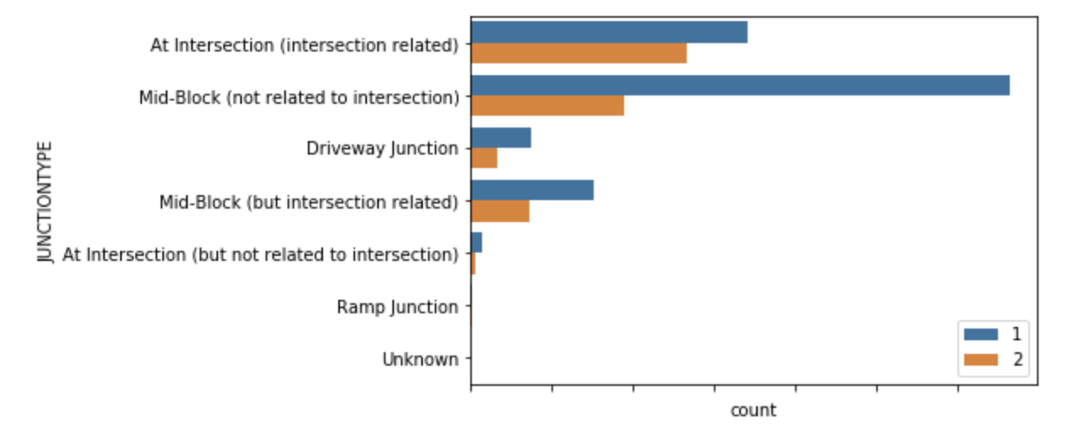
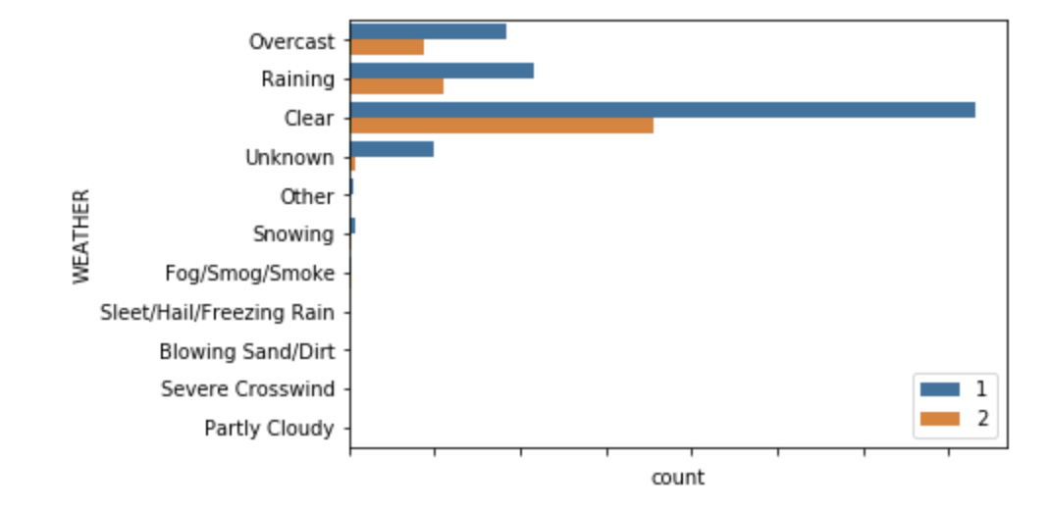
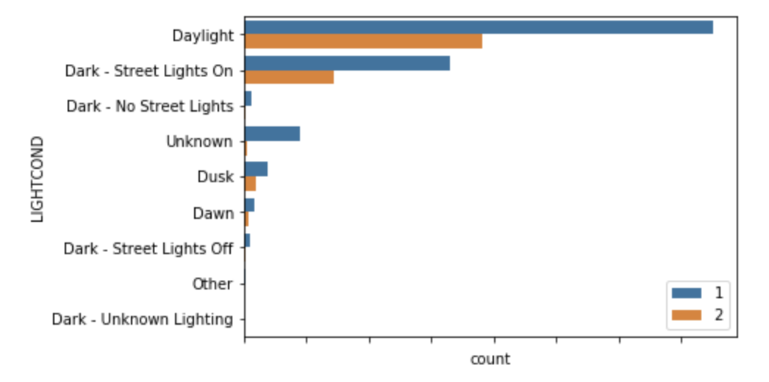
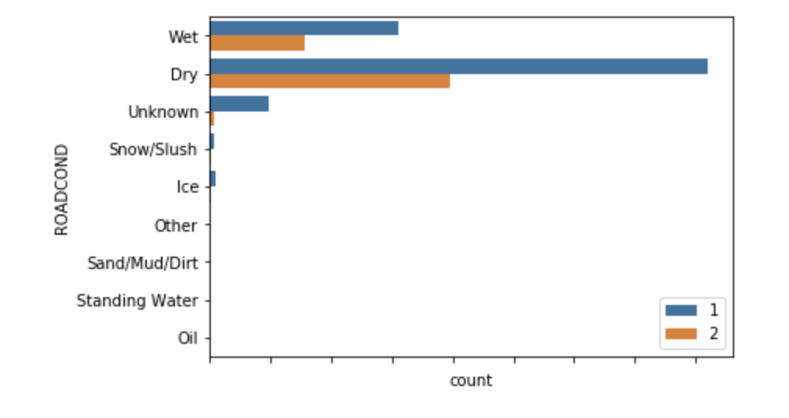
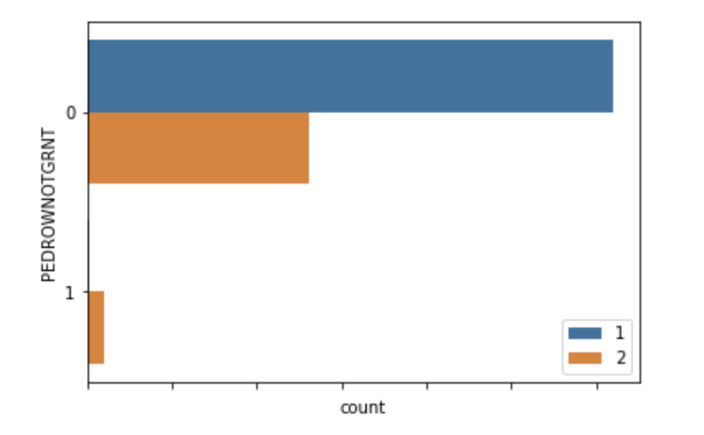
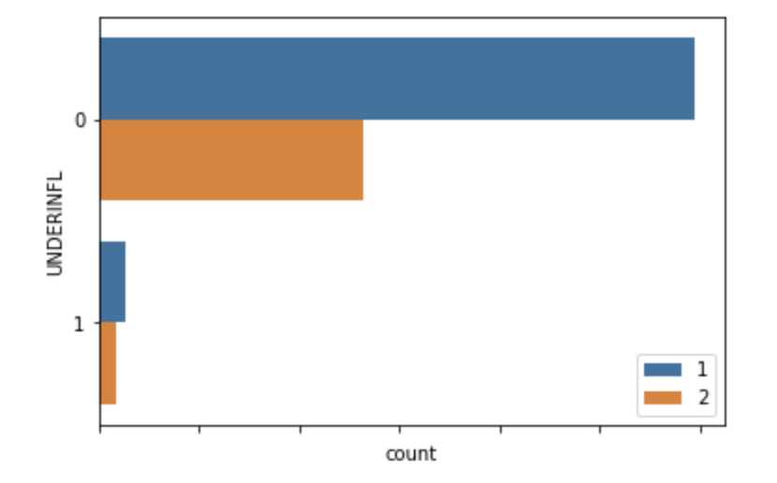

DATA VISUALISATION
Graphs were created to enable assessment of:
Any initial trends
If any of the selected attributes weren’t useful in the ML models.
The graphs created looked at the number of occurrences with severity as a categorisation against the following attributes:
Junction Type
Weather
Light condition
Road Condition
Speeding
Under influence of drugs/alcohol
Pedestrian given right of way
From the figures, it was observed that the highest number of collisions of both severities occur during ideal conditions. This may be a result of increased driving traffic as well as the driver feeling more confident and less focused on their surroundings.

Slide 8
MODELLING
The Seattle Collisions data set has two categories of severity, Severity 1 and Severity 2. The purpose of the models is to predict the likelihood of either severity based on the conditions of the accident. To define the ideal prediction model, a range of models were compared between each other.
The models were:
Random Forest
Decision Tree
Logistic Regression
Gradient Boost
Naïve Bayles
These models were then assessed based on the Jaccard Similarity score and the F1 score, with a visual comparison of a confusion matrix.

Slide 9
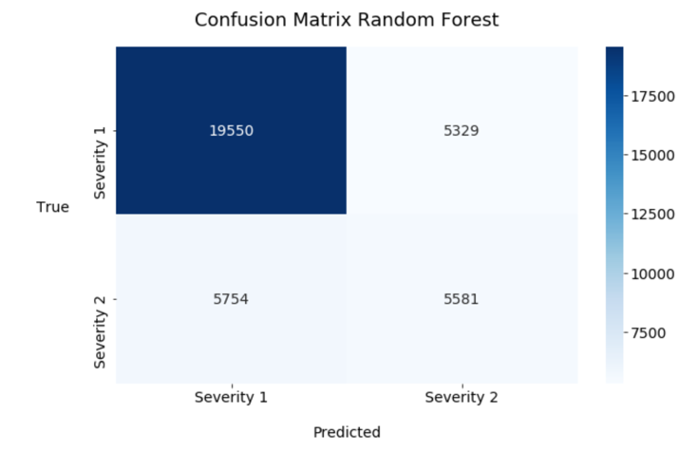
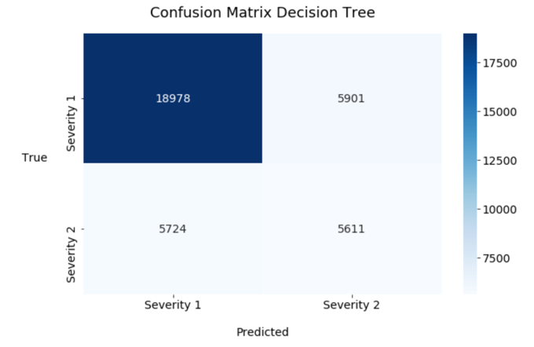
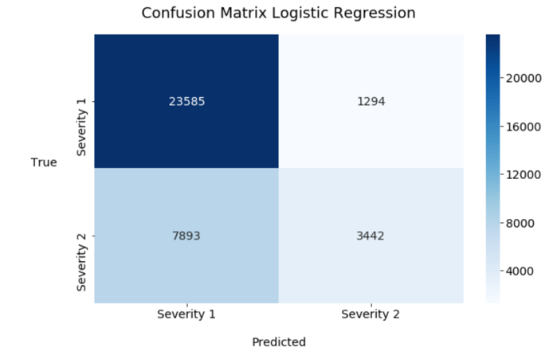
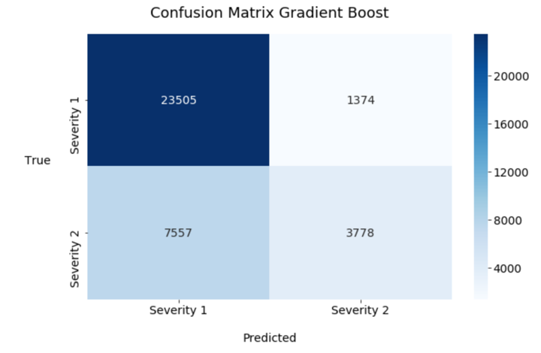
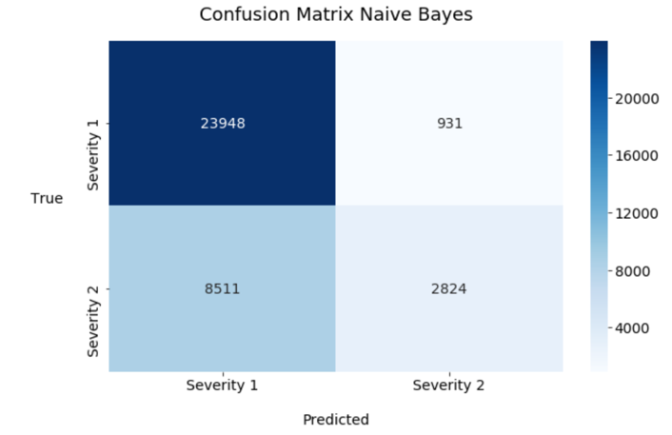
RESULTS
 | Jaccard Similarity Score | F1 Score
Random Forest | 0.694 | 0.692
Decision Tree | 0.679 | 0.680
Logistic Regression | 0.746 | 0.709
Gradient Boost | 0.753 | 0.721
Naïve Bayes | 0.739 | 0.691
The results of each ML model can be seen in the table as a summary of Jaccard Similarity Score and F1 Score. As well as in the confusion matrices.
Gradient Boost ML Model is the best predictor for the severity of an accident.
Models struggled to accurately predict Severity 2 accidents.
This is evident from the confusion matrices, with a severe lack in Severity 2 (and resulting incorrect predictions).

Slide 10
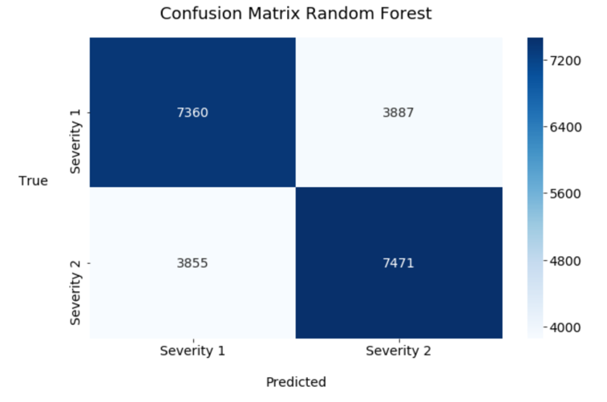
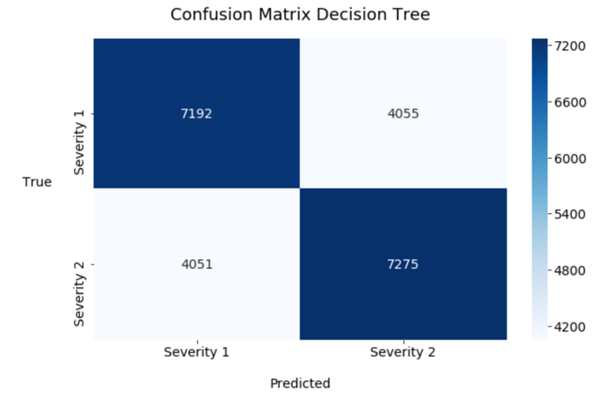
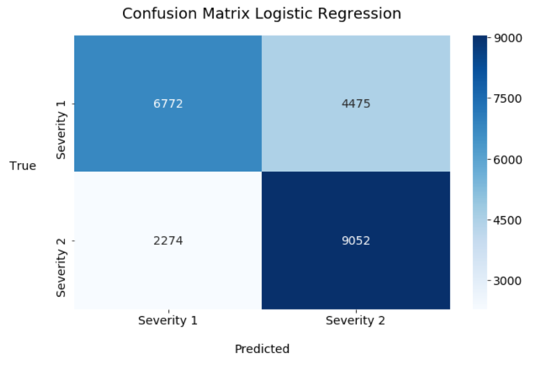
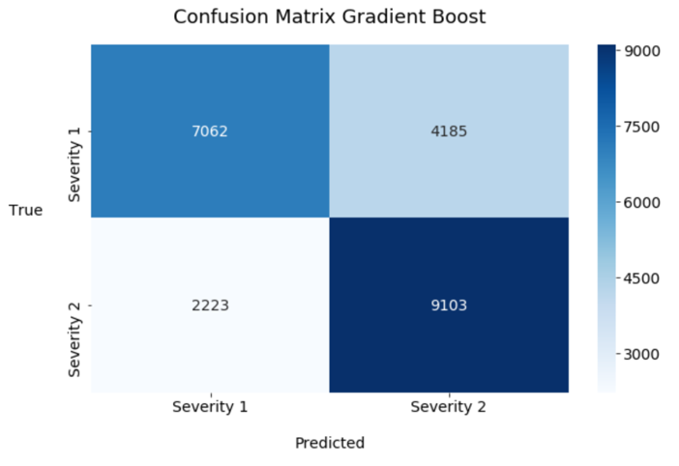
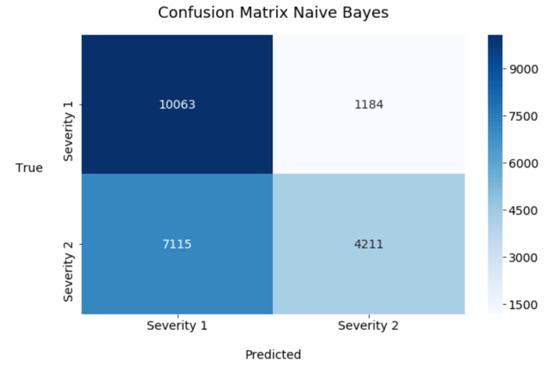
RESULTS CONT.
 | Jaccard Similarity Score | F1 Score
Random Forest | 0.657 | 0.657
Decision Tree | 0.641 | 0.641
Logistic Regression | 0.701 | 0.698
Gradient Boost | 0.716 | 0.714
Naïve Bayes | 0.632 | 0.606
Lack of accuracy with Severity 2 was investigated and deduced that an unbalance in data was present with significantly higher number of Severity 1 accidents.
Under sampling was undertaken to even the number of Severity cases.
The new results of each ML model can be seen in the table and confusion matrices.

Slide 11
DISCUSSION
After applying the under-sampling, the models performed better in making unbiased classification except for the Naïve Bayles model. While there were reductions across each model in Jaccard Similarity and F1 scores, their performance in classifying Severity 2 increased dramatically.
It has been observed that the ideal model to predict the Severity of the accident is the Gradient Boost model, with a Jaccard Similarity Score of 0.716 and F1 Score of 0.714.
Should be noted that a deeper consideration towards the connection between accidents in Seattle areas and any relevant supporting projects from the council may be show interesting connections to reduce the severity of accidents.

Slide 12
CONCLUSION
In this study, the relationship between a range of location based, road conditions and accident details to the resulting severity of the accident was addressed.
From the models built, the ML Model of Gradient Boost produced the best results with a Jaccard Similarity Score of 0.716 and F1 Score of 0.714.
This model can be useful for the Seattle council, as they will be able to better understand the influence that variables can have on the severity of an accident and use that information to develop of interventions in speed management, infrastructure design and enforcement of traffic laws.
For insurance companies, this can be useful to improve the questionnaires asked of car owners submitting for insurance premiums and how high they should be. For example, if they drive significantly during the day and in areas that have high intersection accidents, they would look to increase the premium to cover the business.

